Slide 1
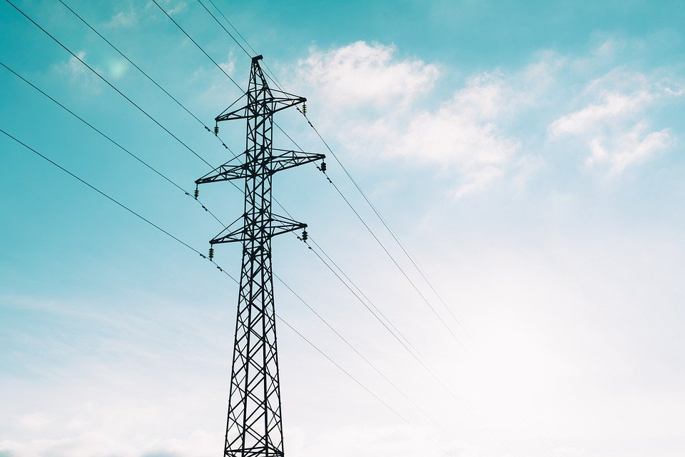
Forecast the Short Term Electricity Load Demand for
Panama Power System
Submitted by: Gary Sampson
Date: July 20, 2021

Slide 2
Project Objective
The main objective of this analysis is to forecast the short term electricity demand (MWh) for Panama power system using a Deep Learning Model.
Benefits of Short Term Electricity Load Forecasting:
Reduces operational planning uncertainty added by the intermittent production of renewable sources.
Minimizes the fossil fuels/hydro electricity production costs in the power grid.
Efficient power grid maintenance planning.

Slide 3
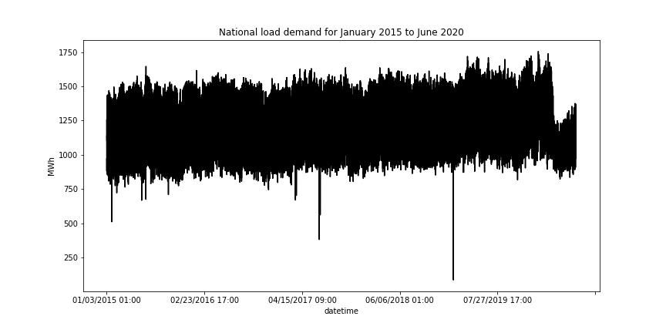
Exploratory Data Analysis
From mid-march 2020, there was a significant drop in load demand probably due to COVID-19 pandemic lockdown.
There were a few intermittent partial drop in load demand due to power supply and/or transmission problems.

Slide 4
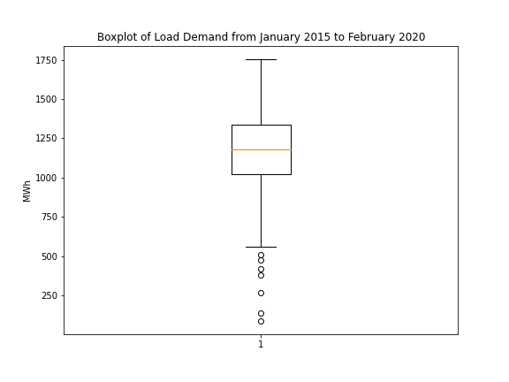
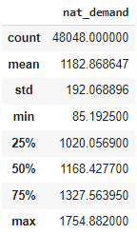
Statistical information for load demand data:
The load demand plot shows that there are several outlier values which may have been due to power system equipment failure. Replace the outliers with a new value of 500 MWh.
Standardisation of the dataset.

Slide 5
Model | Hyperparameters | Validation Mean Absolute Error
Baseline LSTM | Learning rate(lr) = 1e-3 Window size(ws) = 96 Hidden layers(hl) = 2 | 0.3969
GRU | lr = 1e-4; ws = 96; hl = 2 | 0.3842
GRU | lr = 1e-4; ws = 96; hl = 3 | 0.3930
GRU with 1 convolutional layer | lr = 1e-4; ws = 96; hl = 2 | 0.4074
Wavenet with 9 Conv1D layers | lr = 1e-4; ws = 96 | 0.7071
GRU | lr = 1e-4; ws = 168; hl = 3 | 0.8551
GRU | lr = 1e-4; ws = 72; hl = 3 | 0.4619
GRU | lr = 1e-4; ws = 48; hl = 3 | 0.3581
GRU | lr = 1e-4; ws = 24; hl = 3 | 0.2740
Best model: GRU with hyperparameters; learning rate = 1e-4, dataset window size = 24 and hidden layers = 3 with 300, 200 and 100 neurons respectively.

Slide 6
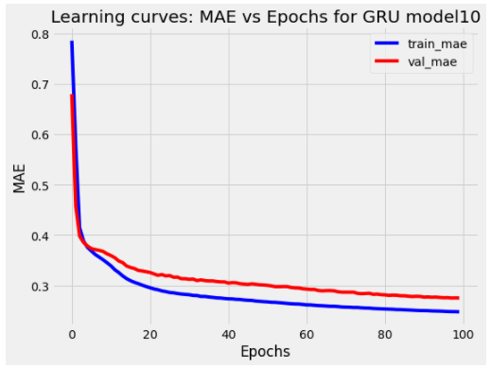
Learning curves for best model:

Slide 7
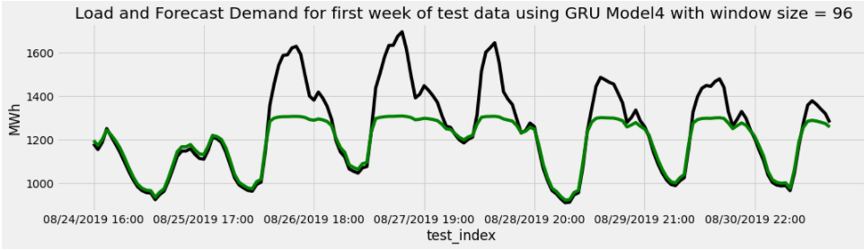
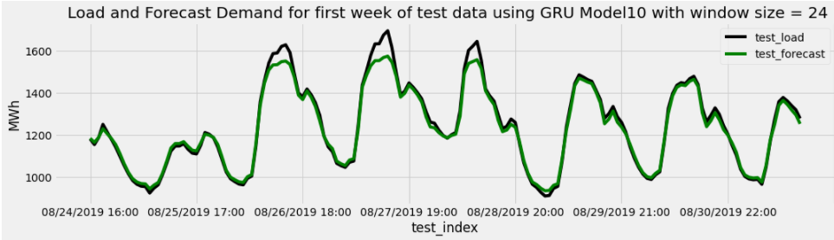
Load Demand Forecast Plots

Slide 8
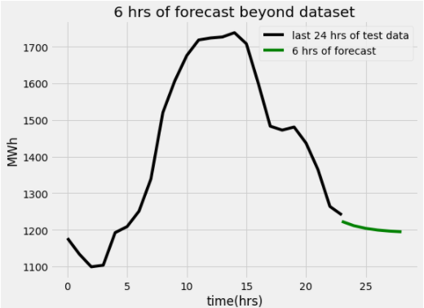
Test load demand Mean Absolute Error for best model: 17.95 MWh

